Slide 1
Chapter 5 for … loop

Slide 2
for Loop Syntax
for (initializationStatement; testExpression; updateStatement)
{
// codes
}

Slide 3
How for loop works?
The initialization statement is executed only once.
Then, the test expression is evaluated. If the test expression is false (0), for loop is terminated. But if the test expression is true (nonzero), codes inside the body of for loop is executed and the update expression is updated.
This process repeats until the test expression is false.
The for loop is commonly used when the number of iterations is known.

Slide 4
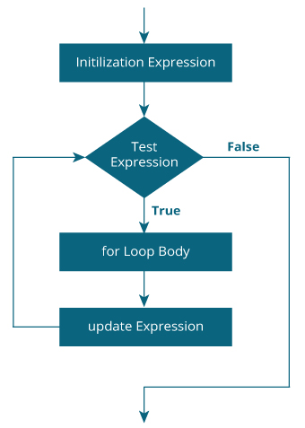
for loop Flowchart

Slide 5
Example: for loop
// Program to calculate the sum of first n natural numbers
#include <stdio.h>
int main()
{
int num, count, sum = 0;
printf("Enter a positive integer: ");
scanf("%d", &n);
// for loop terminates when n is less than count
for(count = 1; count <= n; ++count)
{
sum += count;
}
printf("Sum = %d", sum);
return 0;
}

